Slide 1


MSc in Microbiome in Health and Disease
M2: Introduction to data analysis in R
Frederick Clasen
(frederick.1.clasen@kcl.ac.uk)

Slide 2
Overview and agenda
Description | Activity Type | Date | Day | Start | Finish
Introduction to programming with Linux | Workshop | 10-Oct-23 | Tuesday | 12:00 | 14:00
Introduction to programming with Linux | Workshop | 11-Oct-23 | Wednesday | 12:00 | 17:00
Day 1: 10 October
Day 2: 11 October

Slide 3
Objectives of introduction to R workshop
The goal of this workshop is for you to learn the R environment and the basic of the R programming language.
The goal is NOT for you to be completely fluent in R programming but to be comfortable to start using it for the purpose of biological data analysis.
You will not explicitly be tested on using R
The specific objectives are:
To understand and be comfortable to use RStudio – the integrated development environment (IDE) of R.
To understand base R and how to use base R functions
To understand different data types in R and how to use it
To be able to write your own functions

Slide 4
What is R? – according to Wikipedia
R is a programming language for statistical computing and data visualization. It has been adopted in the fields of data mining, bioinformatics, and data analysis.

Slide 5
What is R? – according to Wikipedia
Computational statistics, or statistical computing, is the study which is the intersection of statistics and computer science, and refers to the statistical methods that are enabled by using computational methods.
A programming language is a system of notation for writing computer programs.
R is a programming language for statistical computing and data visualization. It has been adopted in the fields of data mining, bioinformatics, and data analysis.
Data and information visualization (data viz/vis or info viz/vis)^{[2]} is the practice of designing and creating easy-to-communicate and easy-to-understand graphic or visual representations of a large amount^{[3]} of complex quantitative and qualitative data and information with the help of static, dynamic or interactive visual items.
To learn any new programming language is exactly the same as learning an actual language
There are structures and rules and is ultimately used to perform a specific task

Slide 6
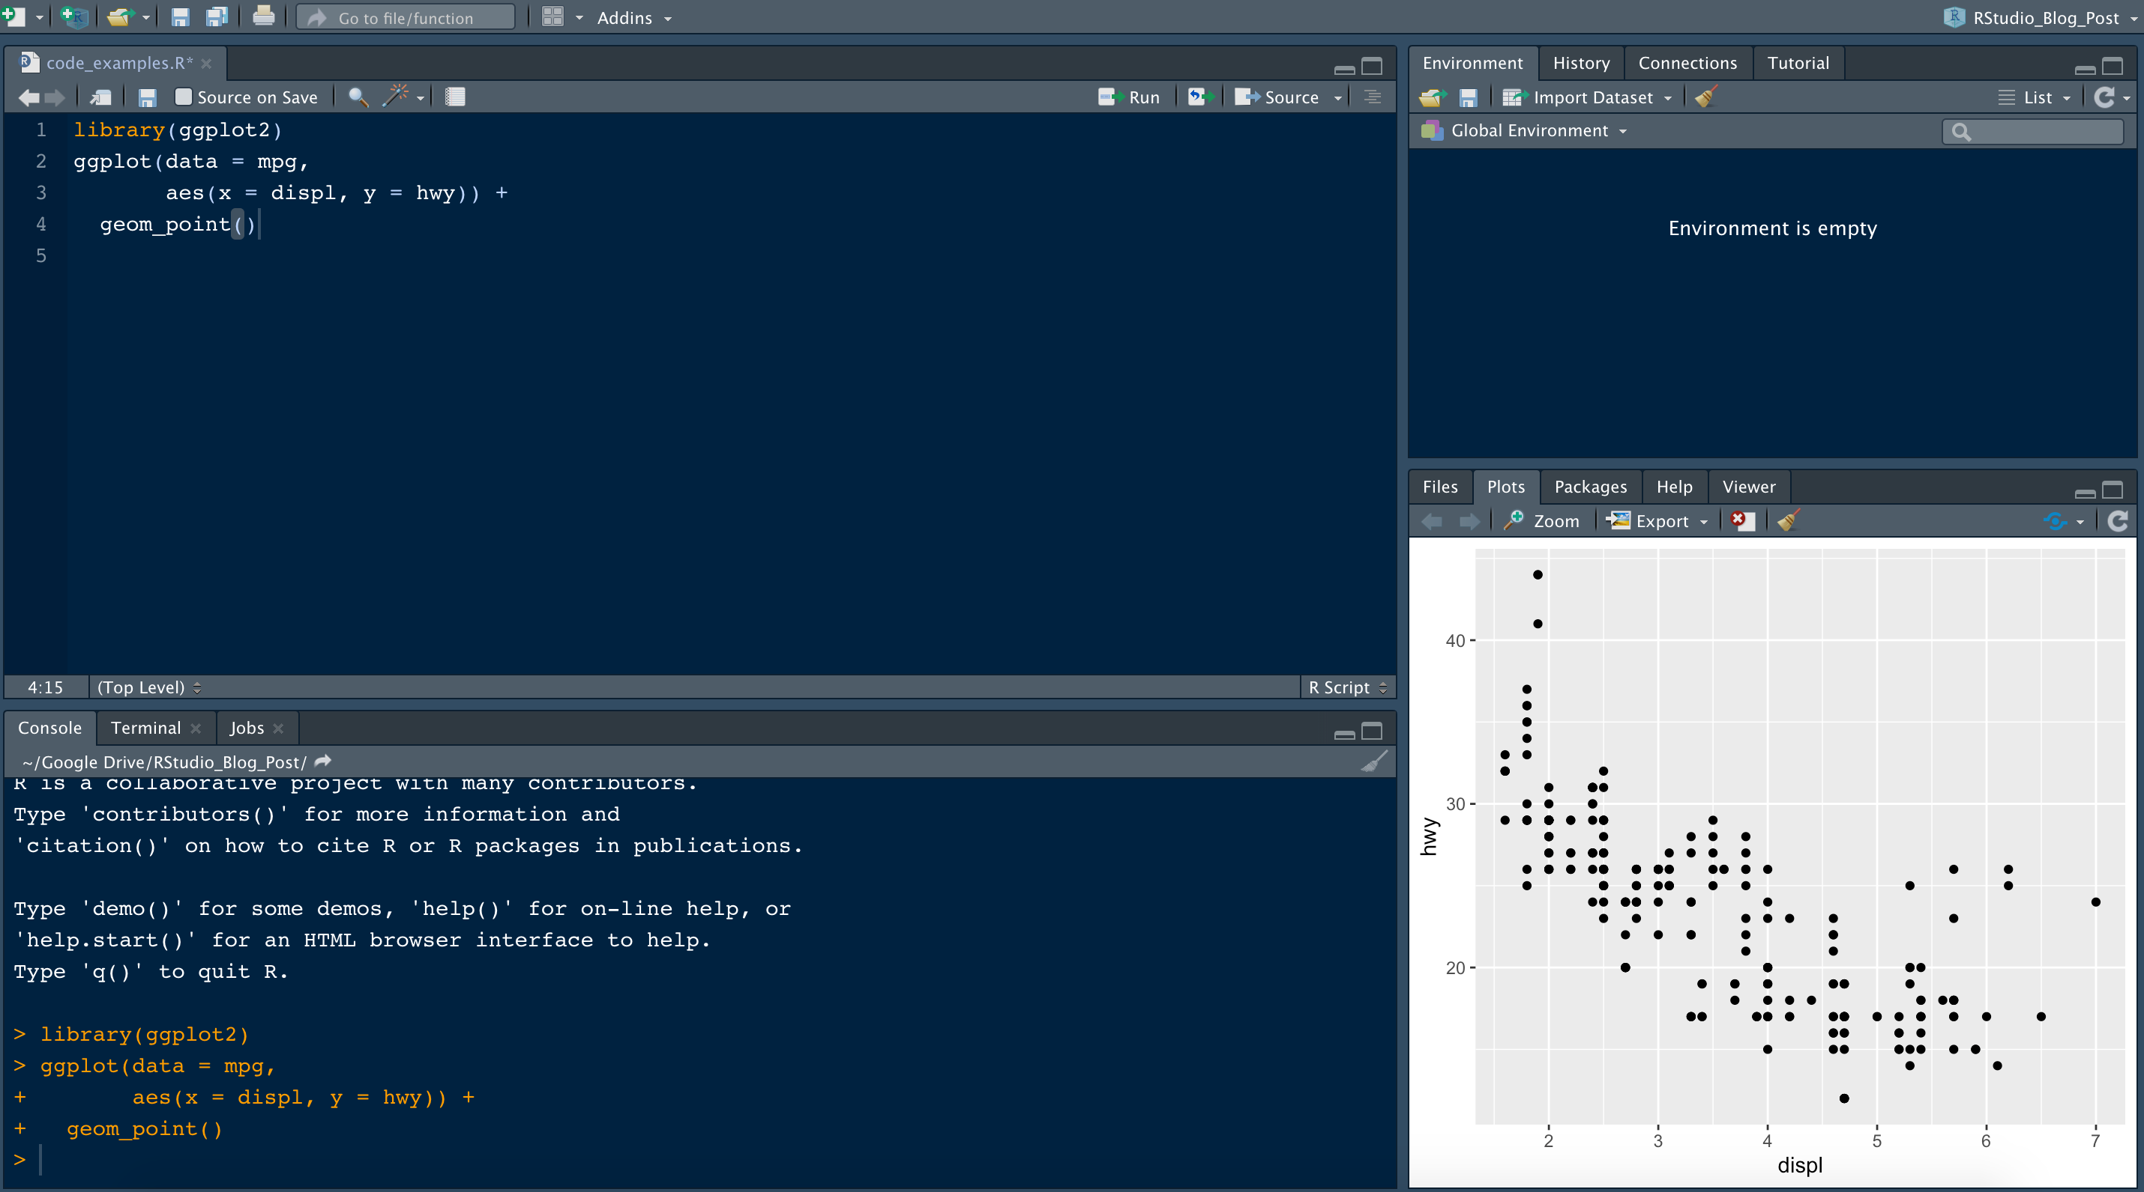
What is the difference between R and RStudio
R the application is installed on your computer and uses your personal computer resources to process R programming language. RStudio integrates with R as an IDE (Integrated Development Environment) to provide further functionality
An IDE is a software application that helps programmers to develop software code efficiently

Slide 7
Install RStudio

Slide 8
Install RStudio

